Slide 1

Domain : Retail - Pharmacy
Topic : Demand Volatility in Retail Pharmacies
Group 9
Darshan Reddy Chilakala Krishna Reddy
Surya Chandra Phani Santhosh Dulam
Sai Praneetha Jaladanki

Slide 2

Reference of the Paper
C.I. Papanagnou, O. Matthews-Amune, Coping with demand volatility in retail pharmacies with the aid of big data exploration, Computers and Operations Research (2017), http://dx.doi.org/10.1016/j.cor.2017.08.009

Slide 3

The Retail Domain
The retail industry at a highest level is the selling of consumer goods to the end buyer.
Analysis of the Retail Domain
Predicting customer purchases
Customer micro-segmentation
Cross selling & up selling
Location-based marketing
Supply chain & logistics optimization

Slide 4

Pharmaceutical Industry - Retail Analysis
Challenges
Demand Volatility and Uncertainty
Increasing inaccuracy of the forecasts
Fluctuations of the medicine inventories
Lack of reliable inventories
Poor customer satisfaction when understocked

Slide 5
Pharmaceutical Industry - Retail Analysis
Solution
Accurate demand planning to balance demand and supply
Waste reduction
Improved Inventory Management
Minimization of over-stock and under-stock
Improved customer satisfaction
Earning better profits

Slide 6

Outcomes of the Paper
How sales structured data can be used in conjunction with non- structured customer data?
How inventory management can predict some inventory as “top-selling”?
On what basis is the “top-selling” measured on specific customer tendency to acquire more information through the internet?

Slide 7
Data in the Paper Time period of the Data - 129 Weeks
Structured Data
Demand figures : Quantity of weekly sales of OTC medicine
Semi Structured Data
Average of the Google index and Newspaper Keyword Index (NKI)
Unstructured Data
Data obtained from YouTube videos
Notes:
SS: Keywords in this study are obtained from Google AdWords website, which provides the volume of searched keywords relating to the indication of the medicine in the particular region
Drug type - Analgesic
Keywords - Analgesic Pains, Fever, Aches, Malaria, Pain Relief, Migraine, Neck Pain, Tooth Aches, Dysmenorrhea, Arthritis
US: Number of views per minute of viewers watching specific YouTube video related to the pain keyword

Slide 8

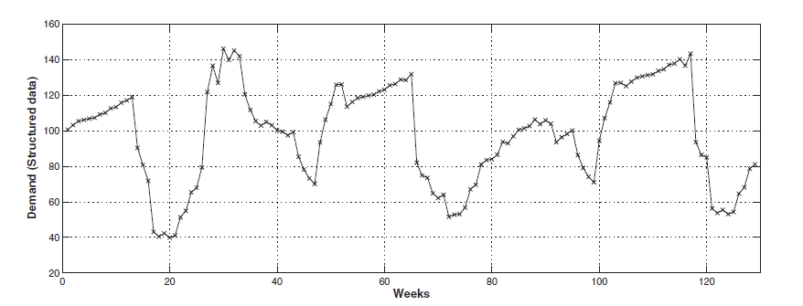
Structured Data

Slide 9

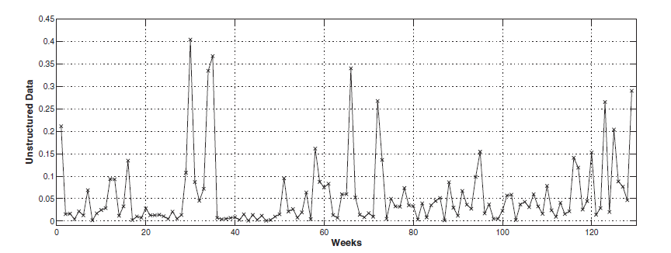
Unstructured Data

Slide 10
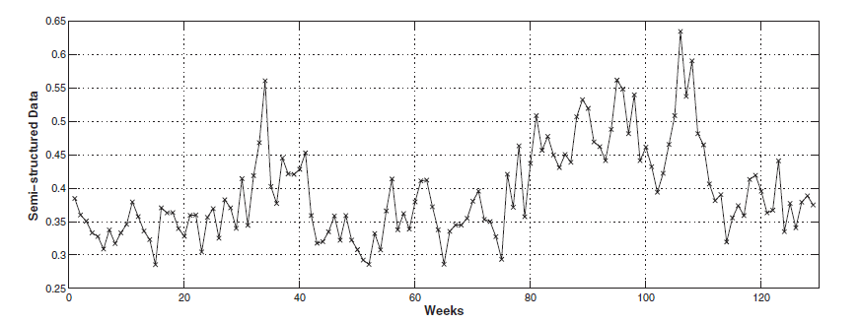
Semi-Structured Data

Slide 11
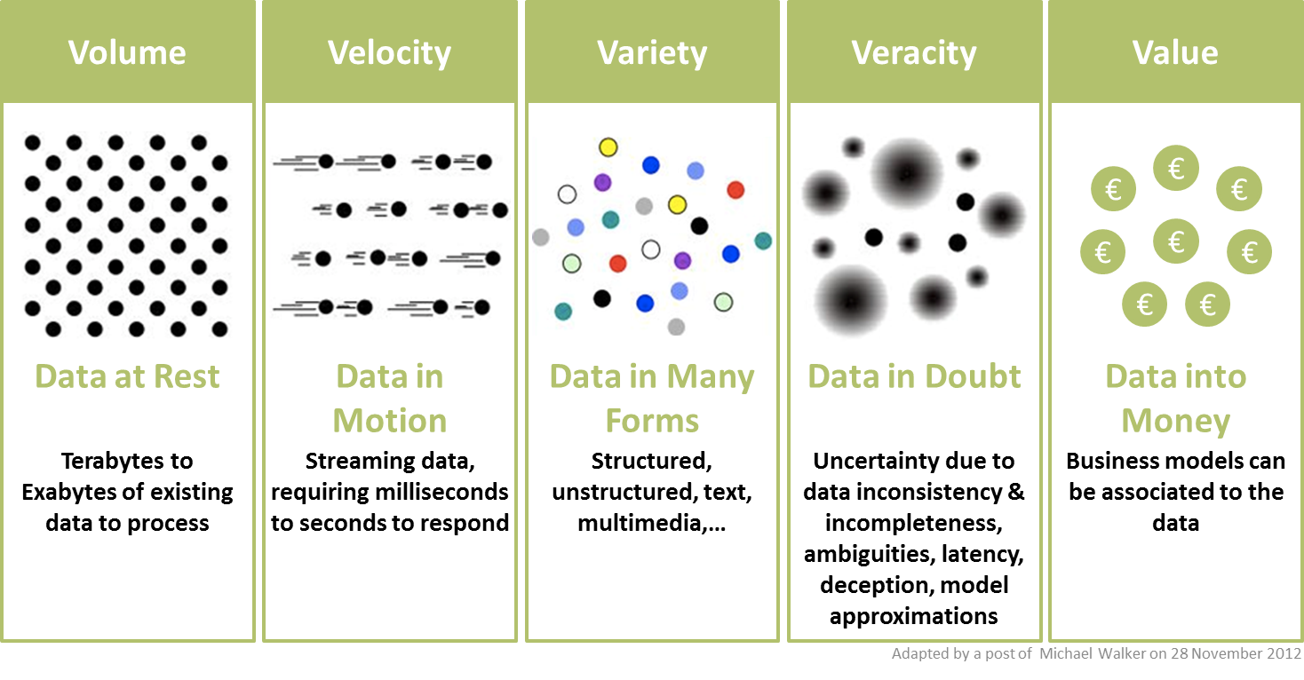
5V’s

Slide 12
Algorithms and Techniques
Time Series Model
VARX
ARIMA Model
Co-Integrating Model
Auto Regression

Slide 13
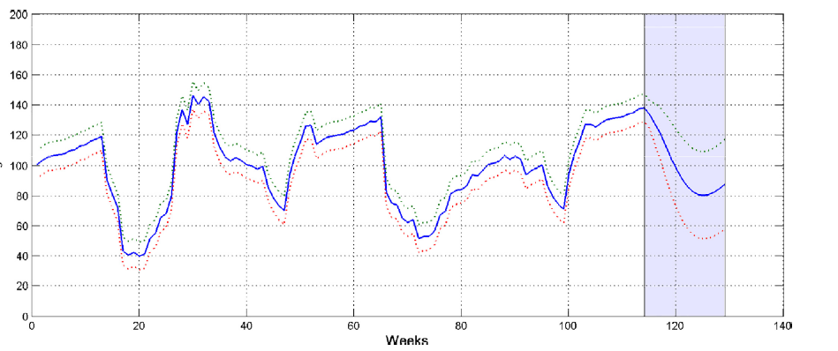
Results and Accuracy - Graphs
Multivariate Analysis

Slide 14
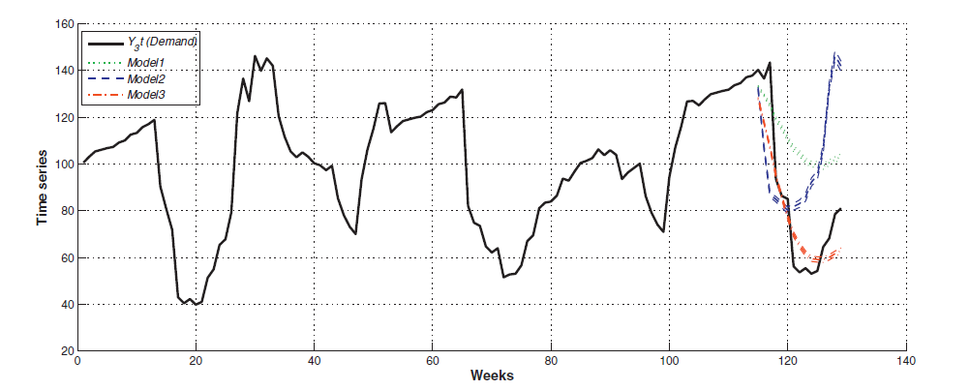
Results and Accuracy - Graphs
Univariate Analysis

Slide 15
Results and Accuracy - Analysis
Potential of Multivariate Time series analysis :
reducing demand forecasting errors in the short term
improving response to demand volatility in retail pharmacy settings.
majorly focused on ‘Variety’ through the consideration of data from different sources

Slide 16
Outcomes of Our Project
Domain: Retail
Topic: Online Retail Store
1) Items customers have purchased together frequently
2) Who are the most loyal customers?
3) Percentage change in total sales over a period of time
4) No .of sales and customers on a particular day.
5) Which item was widely sold in which country?
6) Prediction of sales for the next two months.

Slide 17
References
https://www.sciencedirect.com/science/article/pii/S0305054817302162?via%3Dihub
http://informationcatalyst.com/wp-content/uploads/2015/09/BD-5Vs.png

Slide 18
Thank You!

